Slide 1
Curie Bio Questions
Sego Therapeutics

Slide 2
Nusano relationship – Beyond geographic proximity to Sego’s SLC facility, is there an actual partnership or supply agreement in place with Nusano? Nusano has announced availability of key alpha emitters (e.g., Ac-225, At-211) starting Q4 2025
Sego’s Response
Sego and Nusano share a common backer in Wasatch Group, are co-located on the same Medical Innovation campus in Salt Lake City and have established strong working relationships with the Nusano team. Formal supply agreements are not yet in place but are expected to be straightforward to negotiate given the intertwined founding relationships and shared strategic incentives.
Wasatch Group led the majority of Nusano's $300M+ raised to date and is Sego's lead Seed investor, aligning incentives from isotope production through RLT development
Nusano's accelerator facility targets isotope availability in 2027, matching Sego's first clinical manufacturing need (Ph 0 in 2028)
Co-location eliminates isotope decay losses in transit, simplifies manufacturing scheduling, and integrates logistics from production through GMP to clinical sites
For redundancy, Sego has qualified alternative cGMP 225Ac and 161Tb suppliers (Eckert & Ziegler, Actineer/ITM, NorthStar, TerThera, ITM, Isotopia) independent of Nusano

Slide 3
Team - Who else—beyond the founder, Jeevan Virk—is in place to drive facility buildout, establish the supply chain, and advance six preclinical programs over the first 1–3 years?
Please see slides 7+ for more info
Sego’s Response
Sego has 15 people today scaling to a plateau of 35 by Q1 2027, with full coverage across discovery, GMP manufacturing, clinical translation, and operations already in place. See below for a summary, and more detail in the following slides.
Discovery and preclinical science: Richard Tavare leads research with 15+ years leading clinical imaging strategy at Regeneron across Phase 1-3 programs spanning bispecifics, ADCs, and RLT. Regulatory . Kirstin Zettlitz (Target Biology Lead) brings 20 years across immunology, PK optimization, and radioimmunotherapy including FIH imaging study leadership. Tony Silvestri (Head of Medicinal Chemistry) built the Unnatural Products macrocycle platform from inception supporting $1B+ pharma collaborations, with 10+ programs advanced and 3 DCs expected in 2026
GMP manufacturing and facility: Brandon Buckway (Head of Radiochemistry) has 20+ years of cyclotron-based isotope manufacturing, led GMP production for 5 commercially approved radiopharmaceuticals in Utah, and ran PET probe manufacturing at Huntsman Cancer Institute. Our QA/Facilities consultant is leading the Stage 1A build with 21 CFR Part 211 QA systems experience
Clinical and regulatory: Greg Mullen has taken multiple radiopharmaceutical diagnostics and therapeutics from FIH through approval. Jeevan Virk oversaw Lutathera from FIH through commercial launch. Multiple consultants with decades of experience are in place to support clinical strategy, regulatory and clinical operations
Operations and execution: Adam Badar (Head of Operations) scaled radiopharma facilities across 15+ years. R&D program management and lab operations provide execution discipline across all 6 programs

Slide 4
Fundraise – What exactly are they raising, and what milestones does it fund?
Sego’s Response
Sego is raising $80M in Seed financing, led by Wasatch Group ($20M equity committed plus TI, equipment lease, debt facility), to advance 6 preclinical programs toward the clinic, build a GMP facility supporting Phase 0 and Phase 1 supply, and complete the first 2 Phase 0 imaging studies by mid 2028.
6 preclinical programs across solid tumor indications through target validation, hit finding, lead optimization, and FIH-enabling studies. Programs are focused on small molecule and peptide-based targeting ligands and span prostate, GI and lung cancers.
GMP facility supporting Phase 0 and Phase 1 supply: 2 production lines operational by late 2026, ~$15M total build cost (~40% offset by Wasatch TI allowance), equipment on lease.
First 2 multi-candidate Phase 0 studies in 2028: 3-5 candidates per program, quantitative 177Lu SPECT dosimetry, binary go/no-go (tumor:kidney >3, tumor:marrow >20). Human data selects development candidates.
BD evaluation and potential in-licensing to supplement the internal pipeline, drawing on the founder’s extensive network in the space.
By end of Seed: human dosimetry on 2 programs, operational GMP facility, 4 additional preclinical programs advancing. Positions Sego for a strong Series A in 2028, with transactable data based on recent RLT deal benchmarks.

Slide 5
Strong value trajectory towards revenue generation driven by three phases of flawless execution
Funding Our Future
+$4B
$1B
Benchmarked Valuation*
$375M
1–3 Years
3–5 Years
5+ Years
$100M
Build core business & research capabilities
Seed: $80M+
Develop 6 pre-clin programs against innovative targets
Translate 2 programs to FIH imaging studies
Implement ML/AI capabilities to expedite discovery & development
Translate assets & broaden pipeline
Series A: $150M
Move 2-4 programs into Phase 1 & beyond
Replenish pre-clin pipeline with 6+ new programs
GMP manufacturing suite expansion & operation
Revenue-generating RLT biopharma
Series B:$250M
Readouts from first pivotal studies
Commercialize first assets
Full pipeline of programs from research through to clinical development generated through flywheel
*Benchmarks based on estimated RayzeBio valuation step ups

Slide 6
Current team

Slide 7
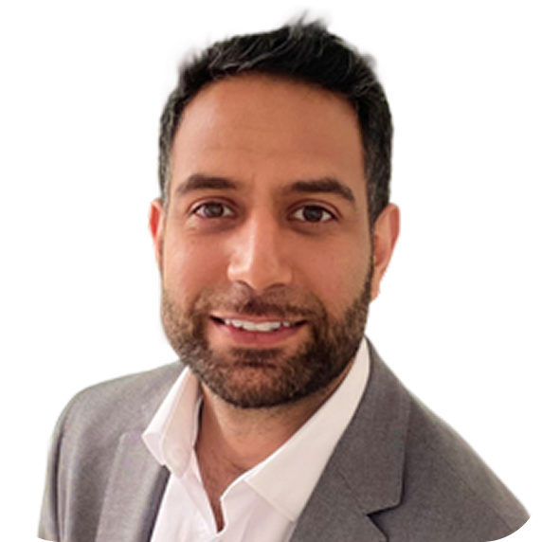
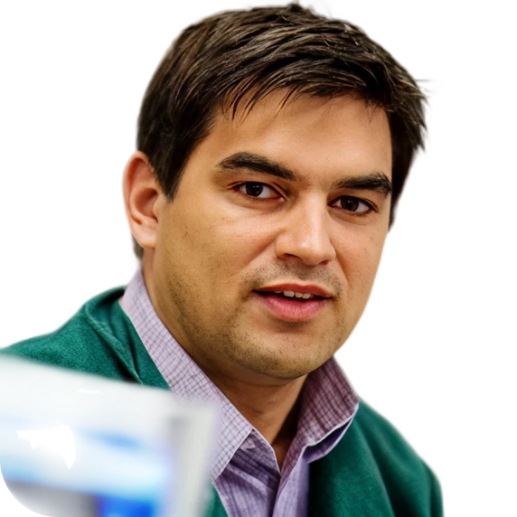
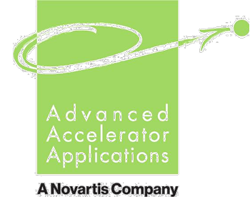







Founded by pioneers in the field of radiopharmaceuticals
Confidential Deck
7
Our Team
Jeevan Virk Chief Executive Officer
Greg Mullen, PhD
Chief Translational Officer
Jeevan Virk is a seasoned innovator and entrepreneur in the radiopharmaceutical space, with a track record of turning breakthrough science into scalable enterprise. He began his career driving oncology-focused initiatives that integrated molecular imaging with targeted radiotherapy, helping shape the evolution of theranostics.
Notable achievements in the field include global responsibility for the Lutathera®,
the first RLT. Responsibility for the RLT portfolio during the launch of Pluvicto®. Leading the RLT early portfolio strategy which encompasses organic and inorganic
growth.
During his tenure, RLT at Novartis scaled from zero to >$10B of forecasted sales.
He aims to repeat this success at Sego to create the first deca-billion RLT biotech.
Greg Mullen is a seasoned leader and innovator in radiopharmaceuticals and molecular therapeutics, with a record of translating breakthrough science into global clinical success. He started by directing oncology-focused programs that integrated molecular imaging with targeted therapies, guiding multiple assets from research to successful FDA approval and launch.
Major achievements include global leadership across radiopharma portfolios, building development pipelines, manufacturing and managing pivotal trials and commercial launches in top-tier biotech organizations. With deep expertise in R&D, clinical strategy, regulatory affairs, and high-performance team leadership, Greg aims to continue advancing transformative therapies and industry-shaping innovation.

Slide 8
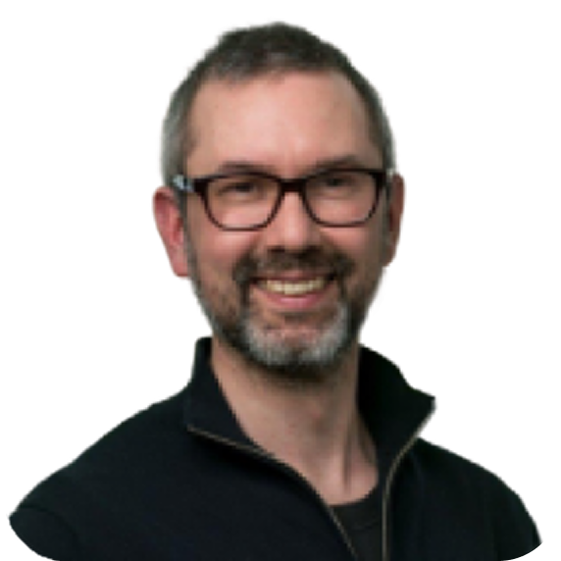
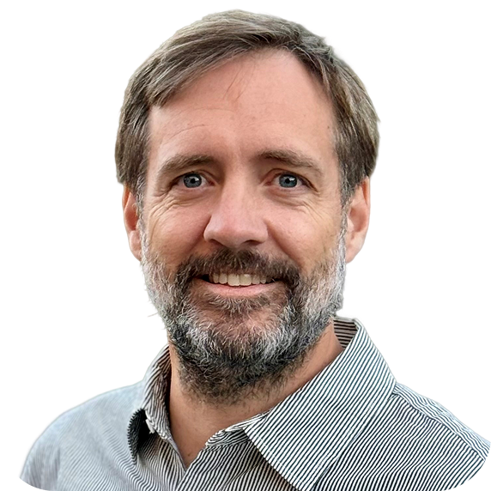






Founded by pioneers in the field of radiopharmaceuticals
Confidential Deck
8
Our Team
Adam Badar, PhD Head of Operations
Richard Tavaré, PhD Head of Research
With a PhD in biomedical imaging and an Executive MBA, Adam brings over 15 years of proven scientific and commercial leadership in radiopharmaceuticals, nuclear medicine, and MedTech innovation. He has successfully delivered major research facility build-outs at leading UK institutions, including King’s College London, University College London, and the Francis Crick Institute.
Adam has scaled high-performing consulting teams at TNO and Philips Healthcare, driving operational efficiency and market impact. He has led product strategy, partnering, and business development across biotech and medtech sectors, including playing a pivotal role in MILabs’ growth and acquisition.
As an operational co-founder, Adam excels at transforming vision into scalable systems, high-caliber teams, and disciplined execution—creating sustainable value and competitive advantage.
Richard Tavaré is a renowned scientist with more than 15 years of experience in oncology diagnostics and therapeutic drug development spanning academia and industry. With a PhD in imaging immunology and deep expertise in molecular imaging, he has spearheaded programs that advanced three novel imaging- targeted molecules into clinical trials.
At Regeneron Pharmaceuticals, Inc., he worked in the Oncology, Global Development, and Therapeutic Protein groups from discovery research through to oncology clinical trials. He initiated a research collaboration that led to the acquisition of a cyclic peptide company to strengthen imaging and targeting platform capabilities. Combining scientific depth with partnership acumen, Richard now brings his track record of translating imaging innovation into clinical and commercial reality to drive the next wave of theranostics.

Slide 9
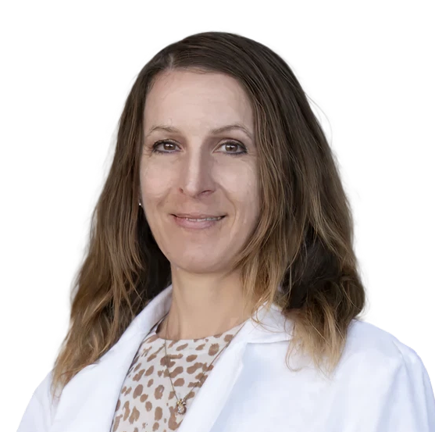
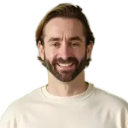
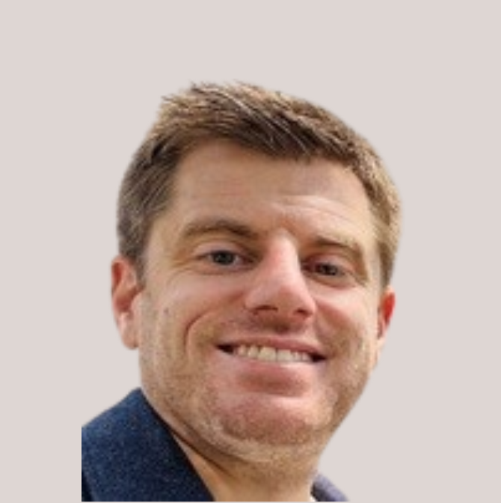
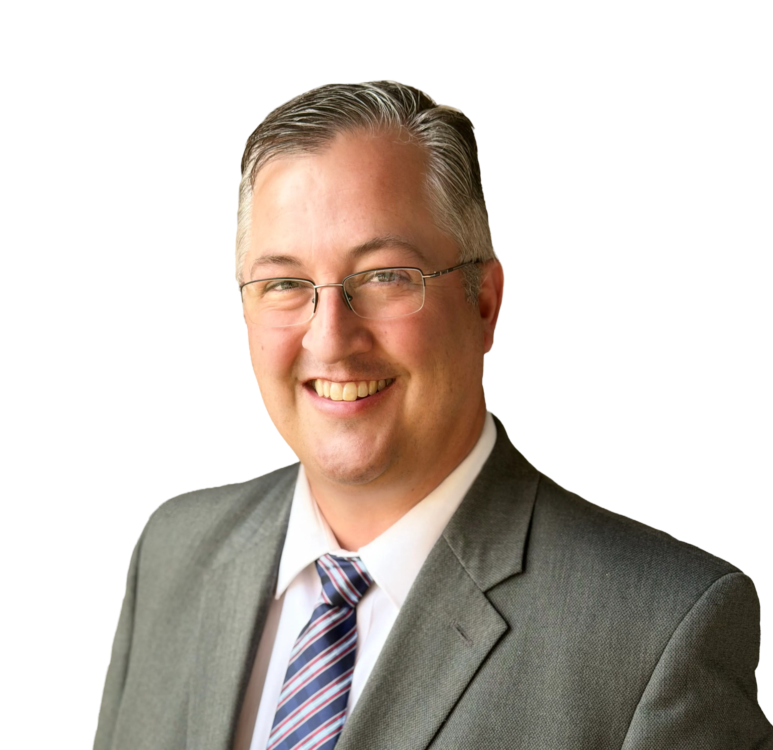
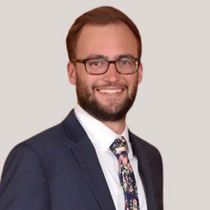











World class radiochemistry, peptide chemistry & theragnostics experience
Confidential Deck
9
Team
Kirstin Zettlitz, PhD Target Biology Lead
Tony Silvestri, PhD Head, Medicinal Chemistry
Anders Eliasen, PhD Sr. Medicinal Chemist
Brandon Buckway, PhD Head of Radiochemistry
Austin Prater, PhD Sr. Scientist, RLT
20 years of experience in immunology, protein engineering & PK optimization
7 years as Asst. Prof. focused on Ab-fragment theranostics (immunoPET, radioimmunotherapy)
PhD in antibody engineering
15 years of peptide chemistry leadership
Founding scientist at Unnatural Products. Built chemistry platform from inception to 50 person team supporting multiple, >$1B R&D collaborations with Argenx, Merck, BridgeBio
PhD in organic chemistry
Principal Scientist at Regeneron leading peptide & bioconjugation team across 8 programs
Sr. Scientist at INDI Molecular; owned CMC for first pre-IND FDA package
Postdoc at Calibr-Scripps; PhD in chemistry, UT Austin
20 years in clinical radiopharmaceutical supply
Instrumental in FDA approval & manufacturing of 5 radiopharmaceuticals in Utah; Fluorodeoxyglucose, Vizamyl, Axumin, Pylarify, and Posluma
PhD in radiochemistry
Sr. Scientist at BigHat Biosciences; built phage display platform for pharma partnerships
Radiolabeled peptides & antibodies with Ga-67, Lu-177, Cu-64 for SPECT/CT
PhD biochemistry, Univ of Missouri

Slide 10
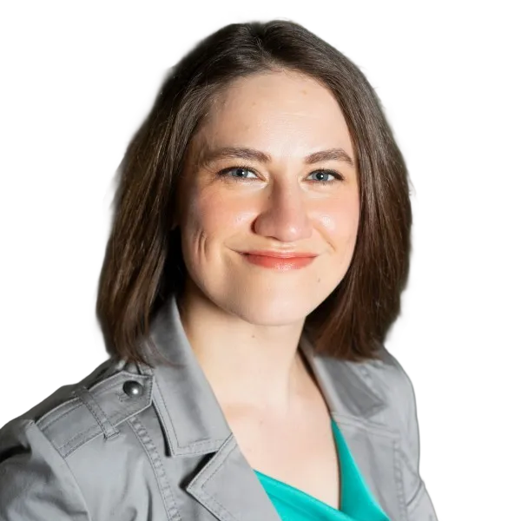
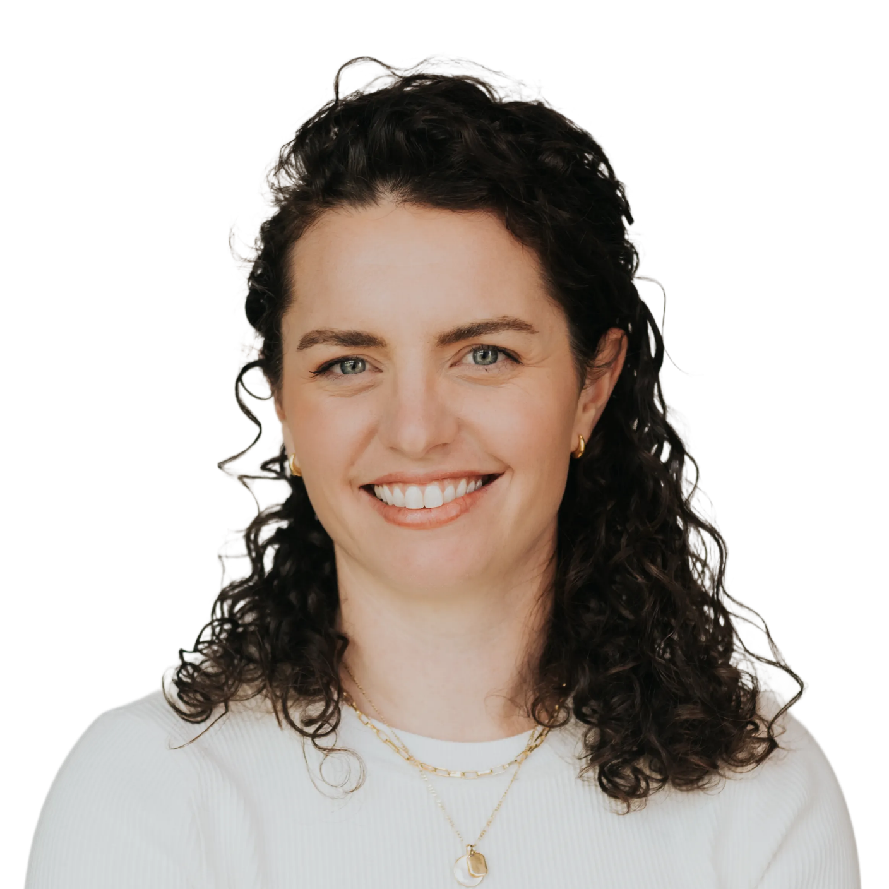
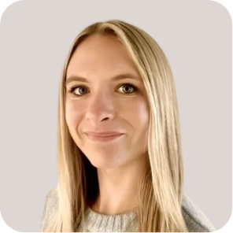
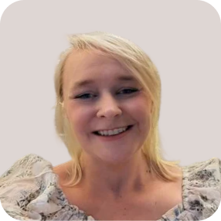
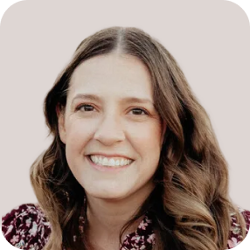






Operational team with deep experience building successful, ML/AI native companies
Confidential Deck
10
Team
Britt McPartland Head of People
Becca Levin, PhD Strategy Lead
Mia Klonsky
AD, R&D Program Mgmt
Kate Brown
Sr. Mgr, Lab Operations
Elizabeth Mitchel, PhD
AD, Research
10 years in building people function at AI/ML biotechs
Central to growing Recursion from 12 to 200 & Pathos from 9 to 50 FTEs
Deeply engaged in Utah scientific talent & education communities
MBA in human resources
8 years in strategic leadership at AI/ML-native biotech companies
Central to Recursion $300M IPO, Eikon $100M Series C
Seamless contributor to scientific, financial, clinical, & BD teams
PhD in chemical biology
10 years of experience in oncology clinical trial operations, strategy, and coordination at HCI, GCAR, and Pathos
Expertise ranges from direct patient facing work to strategic level management of full trial lifecycles
MS in public health
10 years experience in Laboratory Management
Critical to design and implementation of complex automated laboratory systems at Recursion, enabling
Broad knowledge of robotics, LIMS, and animal maintenance
Over 10 years of experience in cancer biology and drug discovery.
Site lead of Pathos' AI-driven oncology lab
Recipient of Susan G. Komen Postdoctoral Fellowship
PhD in cell biology

Slide 11
Deeply experienced team of translational consultants onboarded & building our clinical development strategy
Confidential Deck
11
Team
25+ years as in clinical oncology and Medical Director, Early & Experimental Oncology at a major CROs and alongside US NCI/CTEP
Experienced in RLT development with a range of emitters.
Commercial success: Ipilimumab (Medarex), Olaparib (Kudos / AZ)
25+ years in clinical operations including RLT
Worked with a large number of big and small pharma in clinical development from Phase 1 through post marketing studies
Commercial success: Multiple approved products
Medical Director
Clinical Operations
25 years in pharma and regulatory consulting including RLT
IND and NDA approval lead; recent FDA meetings on RLT for multiple products
Commercial success: Multiple US approvals of radiopharmaceuticals
20 years in pharmaceutical & medical device manufacturing including radiopharmaceuticals
Worked with a large number of large and small pharma across multiple modalities.
Commercial success: Process validation behind several approved products.
Senior Clinical & CMC Regulatory Strategy
cGMP Drug Manufacturing QA/QC
17+ years in regulatory strategy including RLT
Commercial success: Multiple US and EU approvals of radiopharmaceutical products
Recent regulatory (including FDA) for multiple RLT products at different development stages
20 years in R&D and clinical medical physicist in nuclear medicine and RLT
Extensive record of accomplishment in medical physics
Currently Head of Medical Physics at innovative clinical institution
Senior Non-Clinical & Clinical Regulatory
Medical Physicist

Slide 12
Planned team growth

Slide 13
Team as of Q1 2027
HC = 35
Grey = founders
Grey and Black = LT
Dark Green = Research LT
President/CEO
Jeevan Virk
Head of Operations
Adam Badar
FP&A
Head of HR
Britt McPartland
Sr Lab Ops Manager
Kate Brown
Lab Ops Manager
Zsanett Buko
Lab Ops Manager
AD R&D Program Management
Mia Klonsky
Vivarium Ops Manager
Business Operations Manager
Chief Translation Officer
Greg Mullen
Head of Research
Richard Tavare
Head of Radiochemistry and Sr Director of Manufacturing
Brandon Buckway
Radiochemist
Radiochemist
Head of Medicinal Chemistry
Anthony Silvestri
Director of Peptide Chemistry
Anders Eliasen
Peptide Chemist
Peptide Chemist
Associate Director of Computational Chemistry
AD Research (Screening Biologist)
Elizabeth Mitchell
Bioassay Scientist
Target Validation Lead
Kirstin Zettlitz
Strategy Lead
Becca Levin
QA Tech/Reg Tech
Principal Scientist - Screening
Austin Prater
Quality Manager (Contract)
Todd Buchheit
Medical Physics
Facilities
Engineer
Research IT
Biologist
Biologist
Mass Spec Chemist
Linker/Payload Chemist
Imaging Scientist

